Slide 1
Amazon Web Services
Storage Service
Prakash Kumar-DevOps Trainer

Slide 2
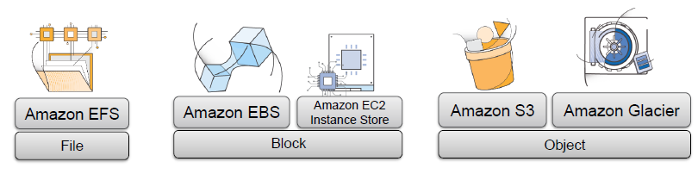
AWS Storage
Amazon EC2 provides you with flexible, cost effective, and easy-to-use data storage options for your instances.
Each option has a unique combination of performance and durability.
These storage options can be used independently or in combination to suit your requirements.
Amazon Elastic Block Store
Amazon EC2 Instance Store
Amazon Elastic File System (Amazon EFS)
Amazon Simple Storage Service (Amazon S3)
Amazon Glacier
Prakash Kumar-DevOps Trainer

Slide 3

Amazon Simple Storage Service (Amazon S3)
Amazon Simple Storage Service (Amazon S3) is an object storage service that offers industry-leading scalability, data availability, security, and performance.
This means customers of all sizes and industries can use it to store and protect any amount of data for a range of use cases, such as websites, mobile applications, backup and restore, archive, enterprise applications, IoT devices, and big data analytics.
Amazon S3 provides easy-to-use management features so you can organize your data and configure finely-tuned access controls to meet your specific business, organizational, and compliance requirements.
Amazon S3 is designed for 99.999999999% (11 9's) of durability, and stores data for millions of applications for companies all around the world.
Prakash Kumar-DevOps Trainer

Slide 4

S3 is a object based storage services, Here the meaning of Object is a data.
As a customer, you can upload your data (Object) to AWS S3 service.
The meaning of object is the data which can be converted into a binary format
For example: PDF, docs, Images, Videos, Source Code like html/java/python file
Backup data etc
AWS spreads your data across multiple devices in the backend so that data can be available from any backend devices.
Prakash Kumar-DevOps Trainer

Slide 5
AWS S3 Key Points
Size of a single object: 0-5TB
You can upload unlimited object in a single bucket , It means AWS allow us to upload
Unlimited object. Capacity of AWS is unlimited.
AWS follows pay as you go model, so changes will be applicable based on usage.
Bucket is a logical representable in AWS S3, Bucket is not a physical entity.
You can upto 200 buckets in a your AWS account. If required you can increase limit by raising a AWS support case with AWS team
When you upload a file using AWS CLI, you will receive a success message 200 code.
AWS S3 is a region specific service provided by AWS
https://s3-us-west-2.amazonaws.com/prakash-ethans
Prakash Kumar-DevOps Trainer

Slide 6
Amazon S3 concepts
Buckets
A bucket is a container for objects stored in Amazon S3.
Every object is contained in a bucket.
For example, if the object named photos/puppy.jpg is stored in the prakash-ethans bucket, then it is addressable using the URL http://prakash-ethans.s3.amazonaws.com/photos/puppy.jpg.
You can create upto 200 buckets(default limit) in a AWS account.
Objects
Objects are the fundamental entities stored in Amazon S3.
Objects consist of object data and metadata.
We can also specify custom metadata at the time the object is stored.
You can upload unlimited objects to a single bucket
Size of an object limit 0-5 TB
Prakash Kumar-DevOps Trainer

Slide 7
Key
A key is the unique identifier for an object within a bucket.
Every object in a bucket has exactly one key.
Every object in Amazon S3 can be uniquely addressed through the combination of the web service endpoint, bucket name, key, and optionally, a version.
For example, in the URL http://doc.s3.amazonaws.com/2006-03-01/AmazonS3.wsdl, "doc" is the name of the bucket and "2006-03-01/AmazonS3.wsdl" is the key.
Regions
We can choose the geographical region where Amazon S3 will store the buckets you create.
We might choose a region to optimize latency, minimize costs, or address regulatory requirements.
Prakash Kumar-DevOps Trainer

Slide 8
Data Consistency model For S3
Read after write consistency for PUT of new objects
Eventual consistence for overwrite PUTS and DELETES (can take some time to propagate)
Prakash Kumar-DevOps Trainer

Slide 9
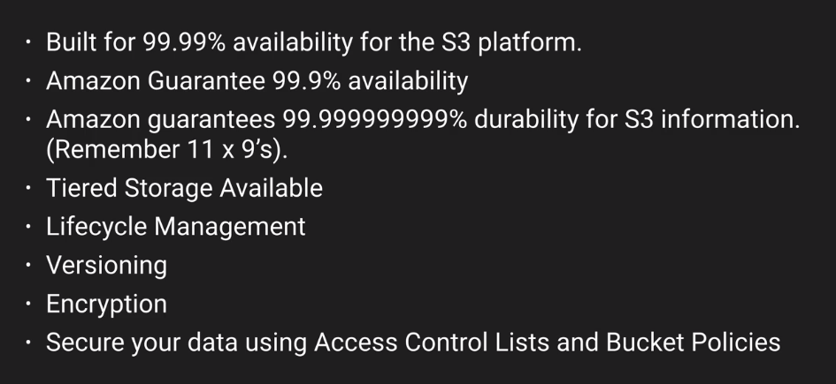
S3- Basics
Prakash Kumar-DevOps Trainer

Slide 10
S3- Storage tiers/Class
Amazon S3 offers a range of storage classes designed for different use cases.
S3 Standard storage
2. S3 Standard - Infrequent Access
3. S3 Intelligent – Tiering
4. S3 One Zone - Infrequent Access
5. S3 Glacier
6. S3 Glacier Deep Archive
Prakash Kumar-DevOps Trainer

Slide 11
S3- Storage tiers/Class
Amazon S3 Standard (S3 Standard)
S3 Standard offers high durability, availability, and performance object storage for frequently accessed data. Because it delivers low latency and high throughput, S3 Standard is appropriate for a wide variety of use cases, including cloud applications, dynamic websites, content distribution, mobile and gaming applications, and big data analytics.
Key Features:
Low latency and high throughput performance
Designed for durability of 99.999999999% of objects across multiple Availability Zones
Resilient against events that impact an entire Availability Zone
Designed for 99.99% availability over a given year
Backed with the Amazon S3 Service Level Agreement for availability
Supports SSL for data in transit and encryption of data at rest
S3 Lifecycle management for automatic migration of objects to other S3 Storage Classes
Prakash Kumar-DevOps Trainer

Slide 12
S3- Storage tiers/Class
Amazon S3 Standard-Infrequent Access (S3 Standard-IA)
S3 Standard-IA is for data that is accessed less frequently, but requires rapid access when needed. S3 Standard-IA offers the high durability, high throughput, and low latency of S3 Standard, with a low per GB storage price and per GB retrieval fee. This combination of low cost and high performance make S3 Standard-IA ideal for long-term storage, backups, and as a data store for disaster recovery files.
Key Features:
Same low latency and high throughput performance of S3 Standard
Designed for durability of 99.999999999% of objects across multiple Availability Zones
Resilient against events that impact an entire Availability Zone
Data is resilient in the event of one entire Availability Zone destruction
Designed for 99.9% availability over a given year
Backed with the Amazon S3 Service Level Agreement for availability
Supports SSL for data in transit and encryption of data at rest
S3 Lifecycle management for automatic migration of objects to other S3 Storage Classes
Prakash Kumar-DevOps Trainer

Slide 13
S3- Storage tiers/Class
Amazon S3 Intelligent-Tiering (S3 Intelligent-Tiering)
The S3 Intelligent-Tiering storage class is designed to optimize costs by automatically moving data to the most cost-effective access tier, without performance impact or operational overhead. It works by storing objects in two access tiers: one tier that is optimized for frequent access and another lower-cost tier that is optimized for infrequent access. For a small monthly monitoring and automation fee per object, Amazon S3 monitors access patterns of the objects in S3 Intelligent-Tiering, and moves the ones that have not been accessed for 30 consecutive days to the infrequent access tier. If an object in the infrequent access tier is accessed, it is automatically moved back to the frequent access tier. There are no retrieval fees when using the S3 Intelligent-Tiering storage class, and no additional tiering fees when objects are moved between access tiers. It is the ideal storage class for long-lived data with access patterns that are unknown or unpredictable.
Key Features:
Same low latency and high throughput performance of S3 Standard
Small monthly monitoring and auto-tiering fee
Automatically moves objects between two access tiers based on changing access patterns
Designed for durability of 99.999999999% of objects across multiple Availability Zones
Resilient against events that impact an entire Availability Zone
Designed for 99.9% availability over a given year

Slide 14
S3- Storage tiers/Class
Amazon S3 One Zone-Infrequent Access (S3 One Zone-IA)
S3 One Zone-IA is for data that is accessed less frequently, but requires rapid access when needed. Unlike other S3 Storage Classes which store data in a minimum of three Availability Zones (AZs), S3 One Zone-IA stores data in a single AZ and costs 20% less than S3 Standard-IA. S3 One Zone-IA is ideal for customers who want a lower-cost option for infrequently accessed data but do not require the availability and resilience of S3 Standard or S3 Standard-IA. It’s a good choice for storing secondary backup copies of on-premises data or easily re-creatable data. You can also use it as cost-effective storage for data that is replicated from another AWS Region using S3 Cross-Region Replication.
S3 One Zone-IA offers the same high durability†, high throughput, and low latency of S3 Standard, with a low per GB storage price and per GB retrieval fee. S3 Storage Classes can be configured at the object level, and a single bucket can contain objects stored across S3 Standard, S3 Intelligent-Tiering, S3 Standard-IA, and S3 One Zone-IA. You can also use S3 Lifecycle policies to automatically transition objects between storage classes without any application changes.
Key Features:
Same low latency and high throughput performance of S3 Standard
Designed for durability of 99.999999999% of objects in a single Availability Zone†
Designed for 99.5% availability over a given year

Slide 15
S3- Storage tiers/Class
Amazon S3 Glacier (S3 Glacier): Backup and Archive:-
S3 Glacier is a secure, durable, and low-cost storage class for data archiving. You can reliably store any amount of data at costs that are competitive with or cheaper than on-premises solutions. To keep costs low yet suitable for varying needs, S3 Glacier provides three retrieval options that range from a few minutes to hours. You can upload objects directly to S3 Glacier, or use S3 Lifecycle policies to transfer data between any of the S3 Storage Classes for active data (S3 Standard, S3 Intelligent-Tiering, S3 Standard-IA, and S3 One Zone-IA) and S3 Glacier. For more information, visit the Amazon S3 Glacier page »
Key Features:
Designed for durability of 99.999999999% of objects across multiple Availability Zones
Data is resilient in the event of one entire Availability Zone destruction
Supports SSL for data in transit and encryption of data at rest
Low-cost design is ideal for long-term archive
Prakash Kumar-DevOps Trainer

Slide 16
S3- Storage tiers/Class
Amazon S3 Glacier Deep Archive (S3 Glacier Deep Archive)
S3 Glacier Deep Archive is Amazon S3’s lowest-cost storage class and supports long-term retention and digital preservation for data that may be accessed once or twice in a year. It is designed for customers — particularly those in highly-regulated industries, such as the Financial Services, Healthcare, and Public Sectors — that retain data sets for 7-10 years or longer to meet regulatory compliance requirements. S3 Glacier Deep Archive can also be used for backup and disaster recovery use cases, and is a cost-effective and easy-to-manage alternative to magnetic tape systems, whether they are on-premises libraries or off-premises services. S3 Glacier Deep Archive complements Amazon S3 Glacier, which is ideal for archives where data is regularly retrieved and some of the data may be needed in minutes. All objects stored in S3 Glacier Deep Archive are replicated and stored across at least three geographically-dispersed Availability Zones, protected by 99.999999999% of durability, and can be restored within 12 hours.
Key Features:
Designed for durability of 99.999999999% of objects across multiple Availability Zones
Lowest cost storage class designed for long-term retention of data that will be retained for 7-10 years
Ideal alternative to magnetic tape libraries
Retrieval time within 12 hours
Prakash Kumar-DevOps Trainer

Slide 17
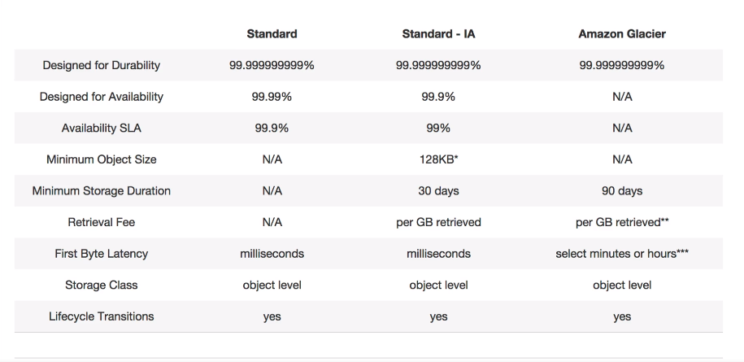
Prakash Kumar-DevOps Trainer

Slide 18

S3- charges
Prakash Kumar-DevOps Trainer

Slide 19
AWS Life Cycle Management
Lifecycle configuration enables you to specify the lifecycle management of objects in a bucket. The configuration is a set of one or more rules, where each rule defines an action for Amazon S3 to apply to a group of objects. These actions can be classified as follows:
Transition actions – In which you define when objects transition to another Storage class. For example, you may choose to transition objects to the STANDARD_IA (IA, for infrequent access) storage class 30 days after creation, or archive objects to the GLACIER storage class one year after creation.
Expiration actions – In which you specify when the objects expire. Then Amazon S3 deletes the expired objects on your behalf.
For more information about lifecycle rules

Slide 20
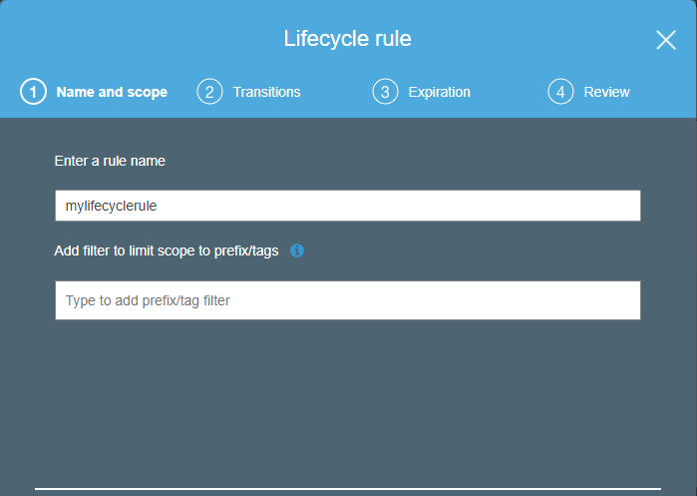
AWS- Life Cycle Management Lab
Prakash Kumar-DevOps Trainer

Slide 21
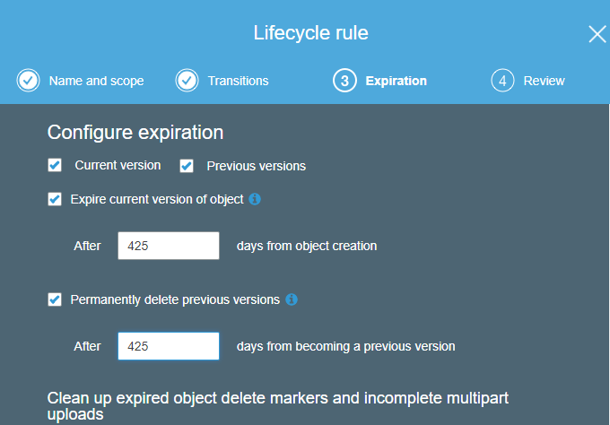
AWS- Life Cycle Management Lab
Prakash Kumar-DevOps Trainer
Notes:
365 days is default value

Slide 22
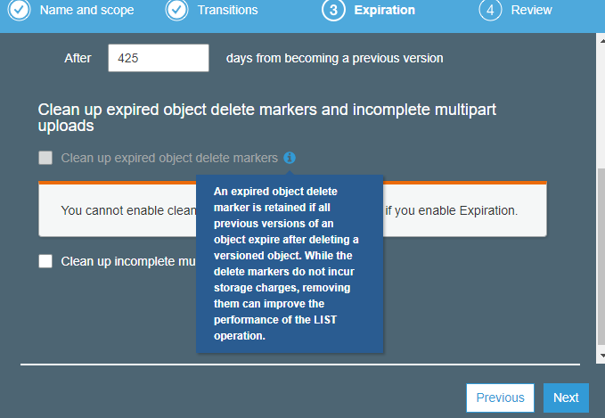
AWS- Life Cycle Management Lab
Prakash Kumar-DevOps Trainer

Slide 23
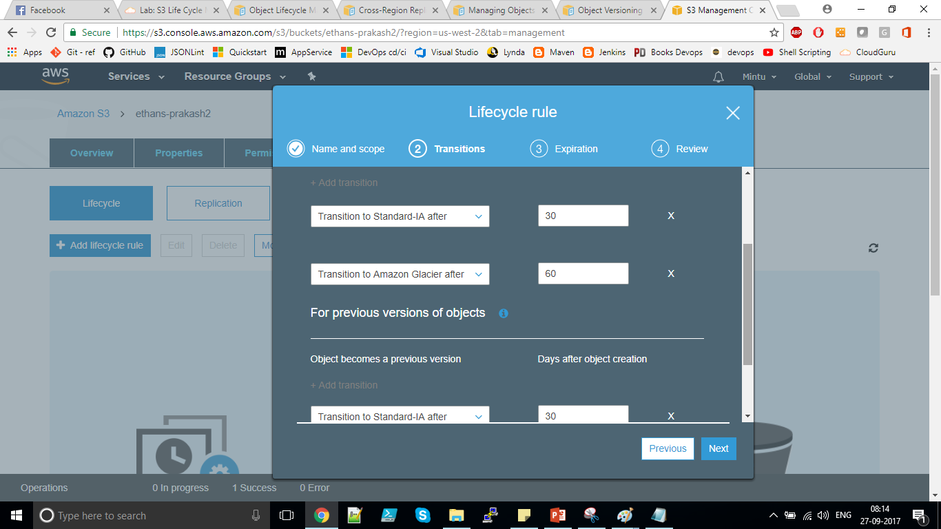
AWS- Life Cycle Management Lab
Prakash Kumar-DevOps Trainer

Slide 24
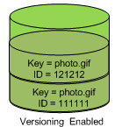
S3 Versioning
Versioning is a means of keeping multiple variants of an object in the same bucket. You can use versioning to preserve, retrieve, and restore every version of every object stored in your Amazon S3 bucket. With versioning, you can easily recover from both unintended user actions and application failures
Prakash Kumar-DevOps Trainer
Notes:
You suspend versioning to stop accruing new versions of the same object in a bucket. You might do this because you only want a single version of an object in a bucket, or you might not want to accrue charges for multiple versions.
When you suspend versioning, existing objects in your bucket do not change. What changes is how Amazon S3 handles objects in future requests.

Slide 25
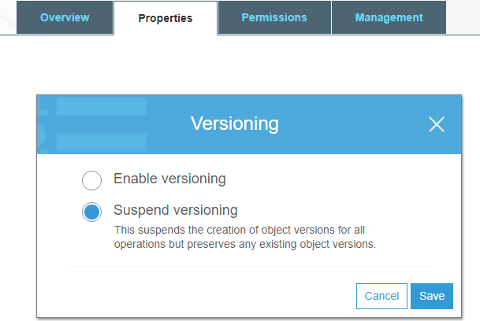
AWS- Versioning Lab
Once you enable versioning, You can only Suspend, By default it is in Disable status.
If you have enabled versioning, Amazon S3 assigns a unique version ID value for the object
Prakash Kumar-DevOps Trainer

Slide 26
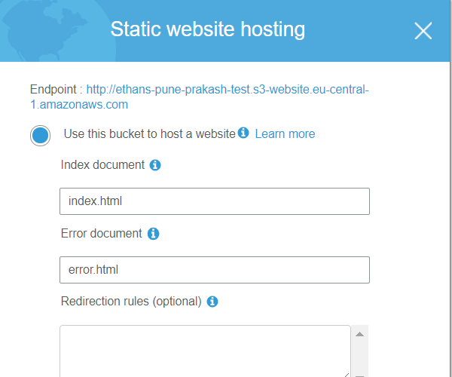
Create A Static Website Using S3
You can host a static website on Amazon Simple Storage Service (Amazon S3). On a static website, individual webpages include static content. They might also contain client-side scripts. By contrast, a dynamic website relies on server-side processing, including server-side scripts such as PHP, JSP, or ASP.NET. Amazon S3 does not support server-side scripting. Amazon Web Services (AWS) also has resources for hosting dynamic websites.
You can create files index.html and error.html
Upload files to the bucket and enable static website feature from properties.
On top of endpoints (static website URL) you can configure Route53 records.
Prakash Kumar-DevOps Trainer

Slide 27
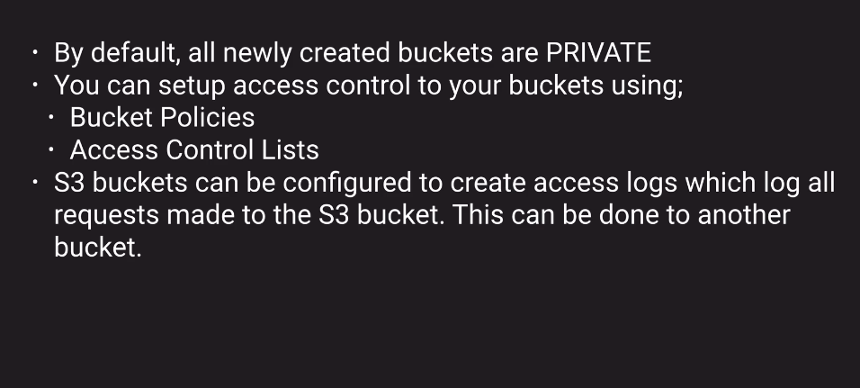
AWS - S3 Security and Encryption
Securing your Bucket:
Prakash Kumar-DevOps Trainer
Notes:
Bydefault all the buckets are private, if you try to access bucket URL, you will XML error.

Slide 28
AWS - S3 Encryption
Use Server-Side Encryption – You request Amazon S3 to encrypt your object before saving it on disks in its data centers and decrypt it when you download the objects.
Use Client-Side Encryption – You can encrypt data client-side and upload the encrypted data to Amazon S3. In this case, you manage the encryption process, the encryption keys, and related tools.
Prakash Kumar-DevOps Trainer

Slide 29
AWS- Cross Region Replication Lab
Cross-region replication is a bucket-level feature that enables automatic, asynchronous copying of objects across buckets in different AWS regions.
To activate this feature, you add a replication configuration to your source bucket.
In the configuration, you provide information such as the destination bucket where you want objects replicated to.
Amazon S3 encrypts all data in transit across AWS regions using SSL
Cross-region replication requires bucket versioning.
Prakash Kumar-DevOps Trainer
Notes:
You can request Amazon S3 to replicate all or a subset of objects with specific key name prefixes
The object replicas in the destination bucket are exact replicas of the objects in the source bucket. They have the same key names and the same metadata—for example, creation time, owner, user-defined metadata, version ID, ACL, and storage class (assuming you did not explicitly specify different storage class for object replicas in the replication configuration). Amazon S3 encrypts all data in transit across AWS regions using SSL. You can also optionally specify storage class to use when Amazon S3 creates object replicas (if you don't specify this Amazon S3 assume storage class of the source object).

Slide 30

S3 Transfer Accelaration
Prakash Kumar-DevOps Trainer

Slide 31
AWS- Cross Region Replication Lab
Use-case Scenarios:
Compliance requirements – Although, by default, Amazon S3 stores your data across multiple geographically distant Availability Zones, compliance requirements might dictate that you store data at even further distances. Cross-region replication allows you to replicate data between distant AWS regions to satisfy these compliance requirements.
Minimize latency – Your customers are in two geographic locations. To minimize latency in accessing objects, you can maintain object copies in AWS regions that are geographically closer to your users.
Operational reasons – You have compute clusters in two different regions that analyze the same set of objects. You might choose to maintain object copies in those regions.
Prakash Kumar-DevOps Trainer

Slide 32
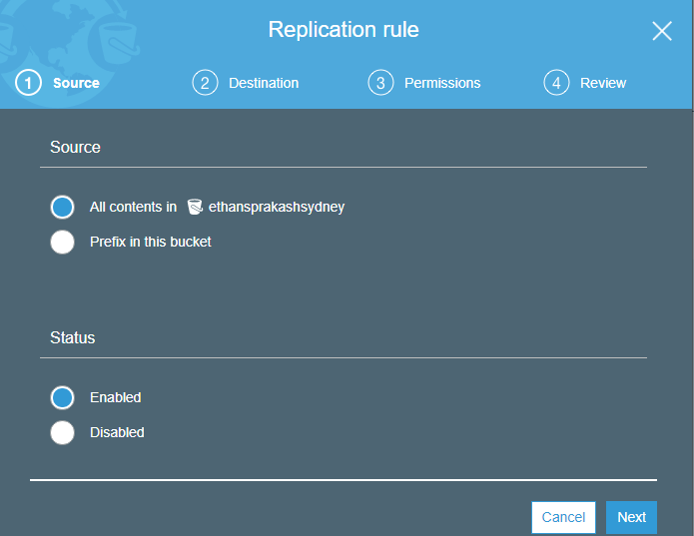
Prakash Kumar-DevOps Trainer
Notes:
Once you delete source object. You can view in versioning in both the regions, but once you delete version changes will not reflect in second bucket.
So if you change something on Source bucket make sure you do changes at destination buckets as well. Ex. Once you delete some version at source area, same version will not delete. At destination.

Slide 33
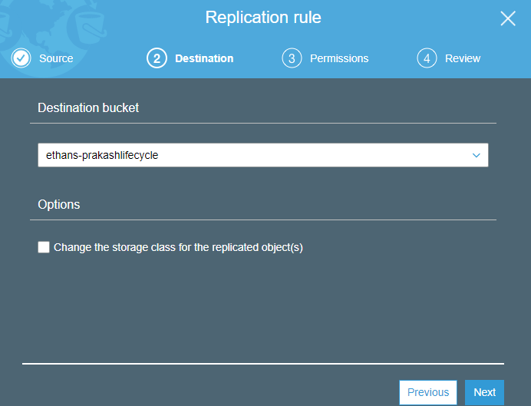
Prakash Kumar-DevOps Trainer
Notes:
Change the Storage Class for the replicated Object: Select when you are planning as Backup

Slide 34
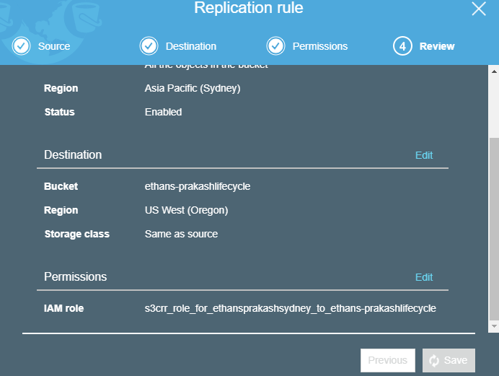
Prakash Kumar-DevOps Trainer

Slide 35
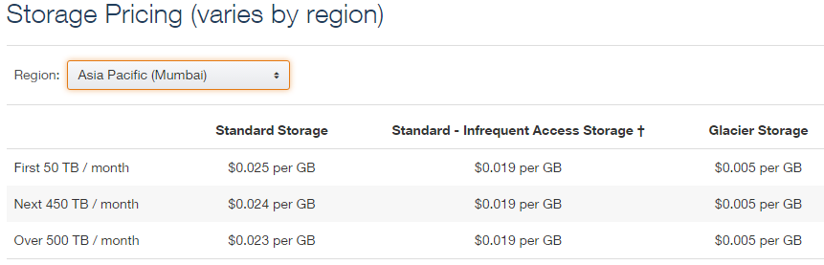
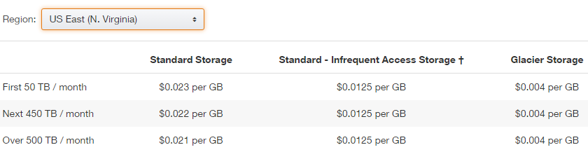
Prakash Kumar-DevOps Trainer

Slide 36
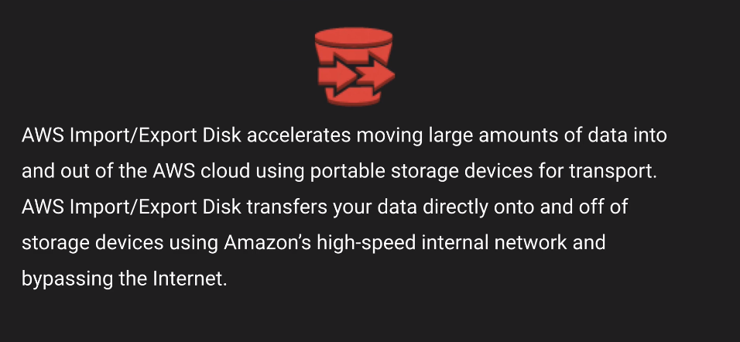
SnowBall- (Import/Export Disk)
Prakash Kumar-DevOps Trainer

Slide 37
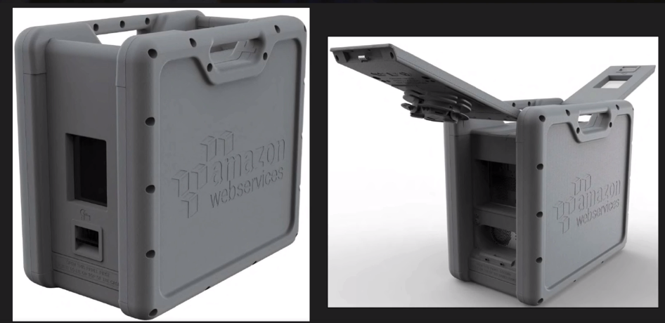
Prakash Kumar-DevOps Trainer
Notes:
Petabytes of capacity

Slide 38
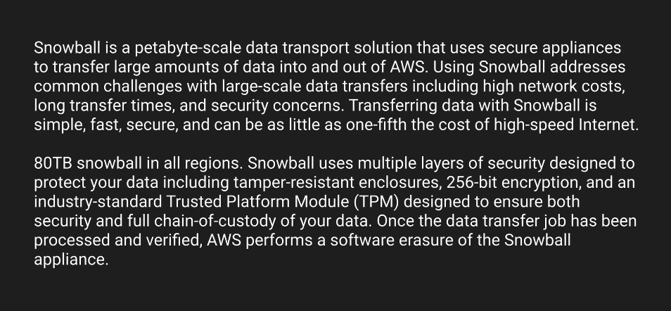
SnowBall
Prakash Kumar-DevOps Trainer
Notes:
You can save 1/5 of cost using snowball
Erasure of snowball appliance: future customer wont be able to recover your data.

Slide 39
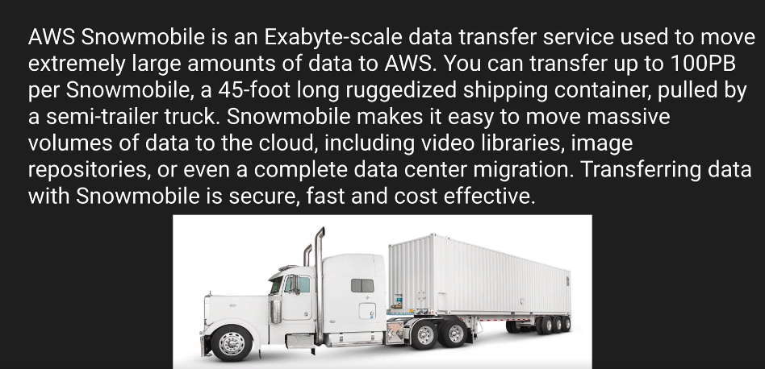
SnowMobile
Prakash Kumar-DevOps Trainer

Slide 40
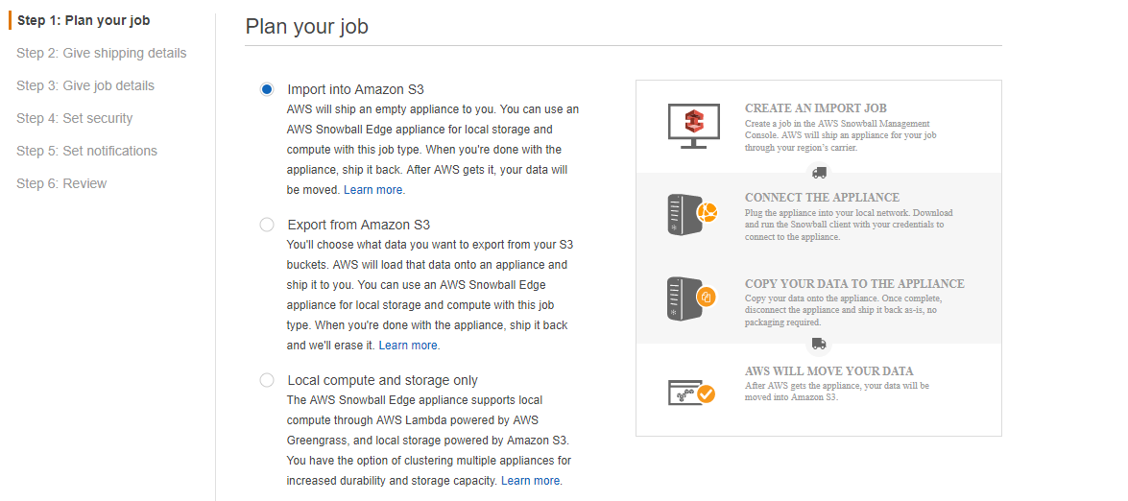
Prakash Kumar-DevOps Trainer

Slide 41
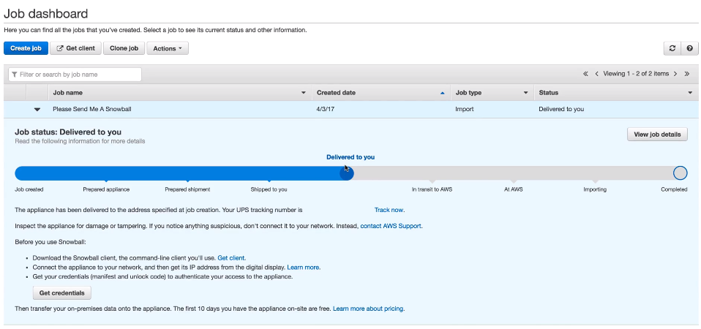
Prakash Kumar-DevOps Trainer

